Slide 1

Osteopathy: EDS AND MCAS
Mast Cell Action – September 2025
Rory Boggett – Osteopath
info@rbosteopathy.co.uk

Slide 2
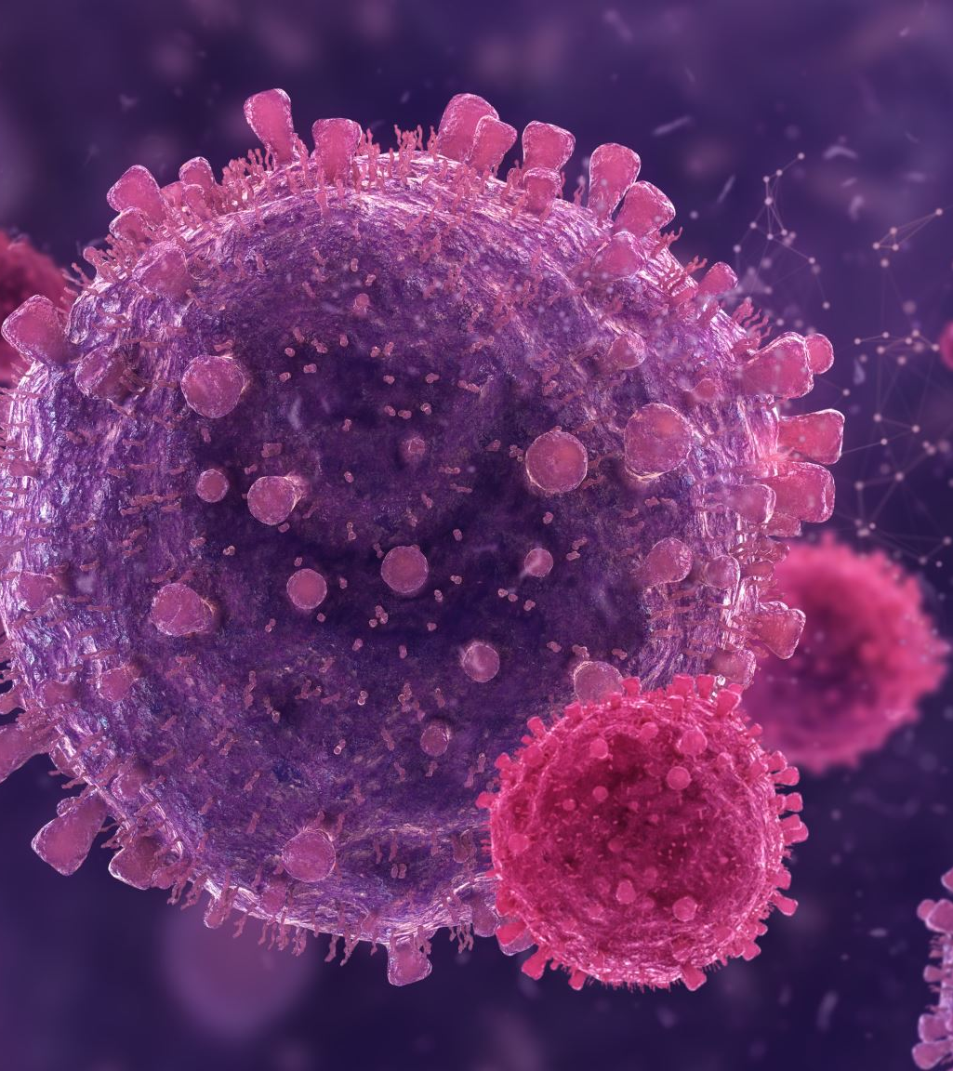
Contents
Osteopathy: what is it? Recognition, concepts and what to expect at your first appointment. How Osteopaths Assess.
"Tissue Issues" EDS and MCAS - connecting the dots between connective tissues and Mast Cells.
Sympathetic verses Parasympathetic responses.
Why Osteopathy? benefits of Osteopathic support for EDS and MCAS patients. what to look for in your Osteopath.

Slide 3
What is Osteopathy?
Regulated UK Health profession
Hands-on specialists in musculoskeletal pain an chronic conditions.
Focus on 4 “principles” of health
Body unity (Mind-body-spirit)
Structure governs function are interrelated
Rule of fluids (blood, lymph, nerve) is supreme (must take precedence)
Treatment based off application of the above three tenets.

Slide 4
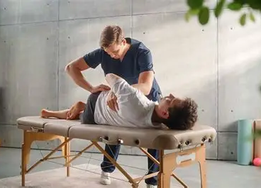
Where to find us
Over 5,000 Osteopaths in the UK.
Some Osteopaths work within the NHS.
Majority are private practice.
General Osteopathic council contains a register of all registered Osteopaths.
Osteopaths with EDS specialties are often registered with the Ehler’s Danlos Society.

Slide 5
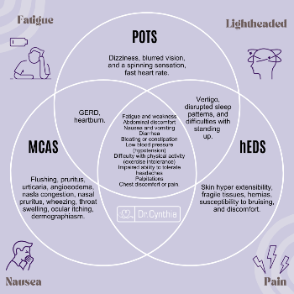
Tissue Issues – EDS AND MCAS/D
Inflammation
Two phases- Acute: defensive and protecting response, tissue repair and healing
Chronic – uncontrolled – tissue damage/ “dis-ease”
EDS – connective tissue disorder, imbalance of collagen fibres
Mast cells mature in connective tissue and assist with opening of fluid channels (vasodilation)
Mast cells have multiple triggers

Slide 6
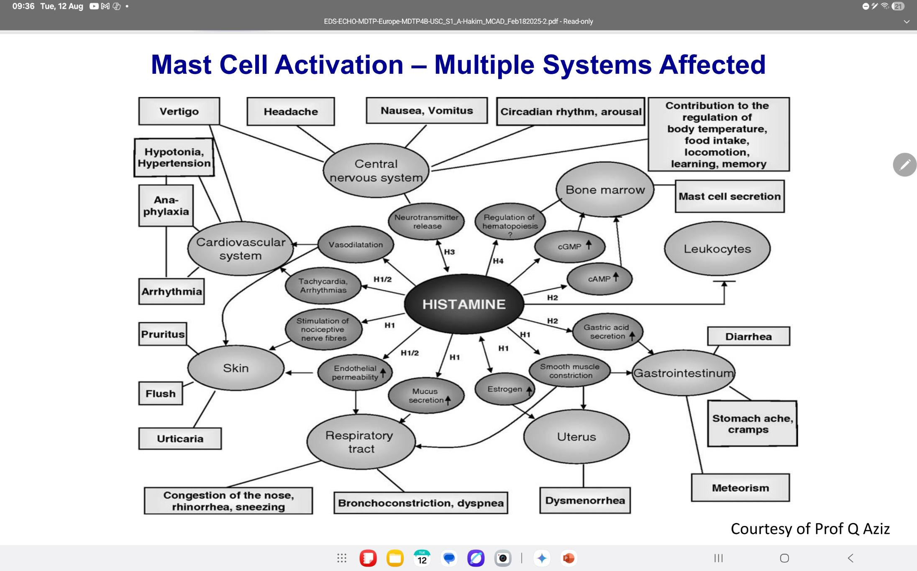

Slide 7
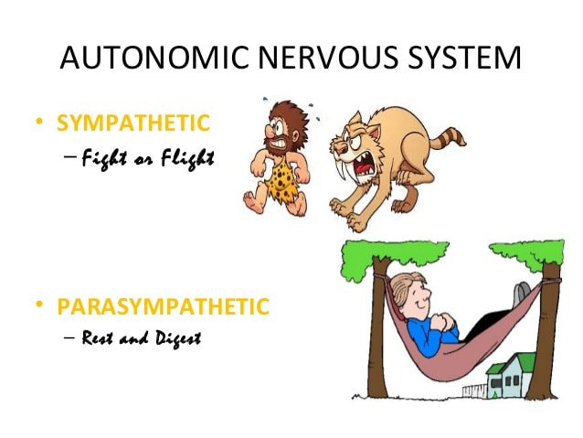
SNS VS PNS? A fight or balancing act?
SNS & PNS regulate body functions
Both work together to create balance.
Can be affected in long term stress/ chronic conditions.
Mast cells can affect autonomic functionality (Theoharides, et al 2024).
SNS creates inflammation, in acute cases helps with tissue healing and repair.
In chronic inflammation – causes tissue damage/disease.

Slide 8
Why Osteopathy?
Specialists in whole person health.
Appointments can last between 30-60 minutes, providing more contact time with patients.
“keeping everything together”
Osteopaths can work with a variety of pain, but also on lifestyle advice and raising awareness to your GP on suspected MCAS diagnosis.

Slide 9
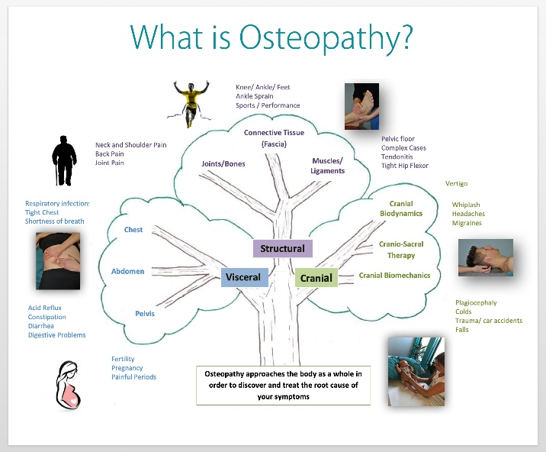
The Osteopathic approach
Osteopathy works on the Sensory afferent mechanisms.
Body uses sensory stimulus to decide what action to take.
MCAS patients often have a low threshold for a histamine response, driven through sympathetic responses.
Osteopathic techniques can use parasympathetic pathways to dampen sympathetic tone.
There is no one size fits all approach, treatments are as variable as the patient.

Slide 10
The Osteopathic Assessment
Case history – Current complaints, medical history, medications, other symptoms. Also includes hobbies, activities and stressors (aggrevating and relieving factors) and red flag screening
Physical assessment – Clinical and postural, including active and passive movements, breathing mechanics.
Diagnosis and further referral – If not MCAS/EDS diagnosed, referral letter for further testing. Diagnosis often includes a “tissue causing symptoms” and a longer “osteopathic diagnosis” of the mechanisms involved.

Slide 11
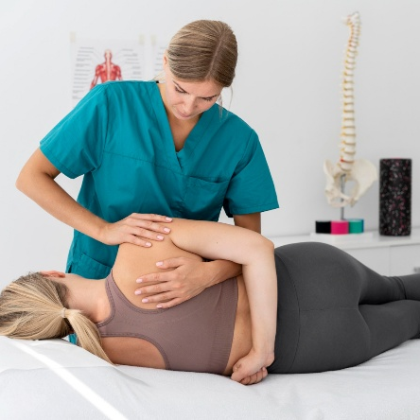
The Osteopathic Treatment
Joint mobilisations
Manipulations – if safe
Soft tissue –including lymphatic work
Cranial Osteopathy
Advice and Exercise
All vary depending on the osteopathic diagnosis, patient history/preferences, and tissue causing symptoms.

Slide 12

In Summary
Osteopaths are primary healthcare professionals.
Diagnose and treat a range of pain related disorders.
Often able to treat complex cases with multiple conditions.
Aid appropriate referrals through GP.

