Slide 1

POTS in Children
Dr Pramod nair
Paediatrician with cardiac expertise
Special interest in pots
Saxon clinic, Milton Keynes

Slide 2

What is pots?
Stands for postural orthostatic tachycardia syndrome
Postural= Related to posture
Orthostatic= upright
Tachycardia= fast heart rate
Syndrome= collection of symptoms or medical conditions

Slide 3
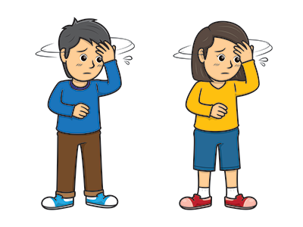
What happens?
When the child is upright might experience
Dizziness
Near faint
faint
Palpitations/ fast heart rate
Along with these might have other symptoms like
Headaches, fatigue, nausea/vomiting, purplish discolouration of extremities, bowel/bladder problems, brain fog, rash, tremors, sleeping difficulties etc.

Slide 4
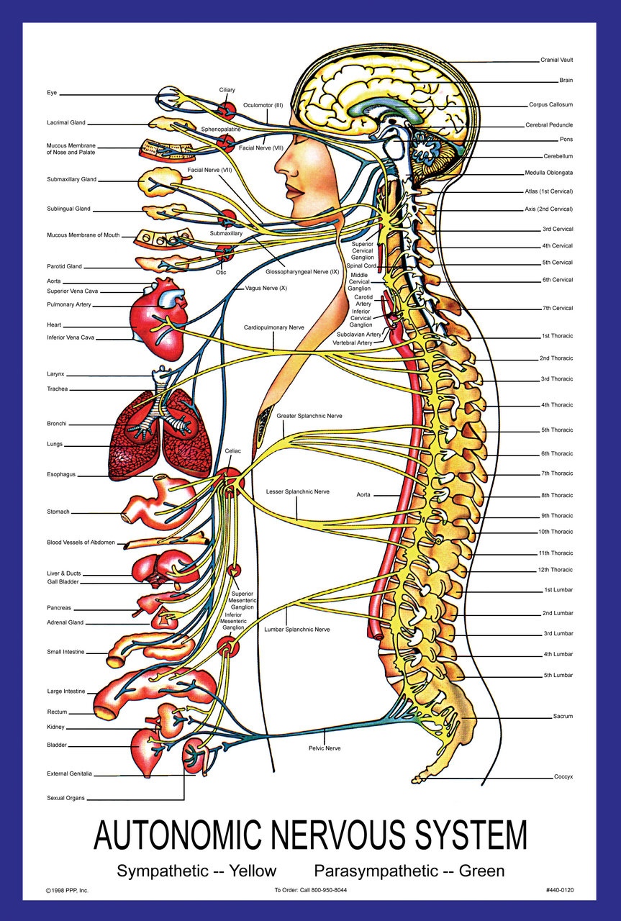
Why does it happen?
Not currently known
It is an autonomic dysfunction
Autonomic nervous system control autonomic activities in the body like your heart rate, gut movements, circulatory response, sweating etc.
Often multifactorial
Can happen as a post viral condition/ part of adolescence/ as a deconditioning effect from being bed ridden or reduced activities, genetics or Increased stress hormones, sometimes unexplained

Slide 5
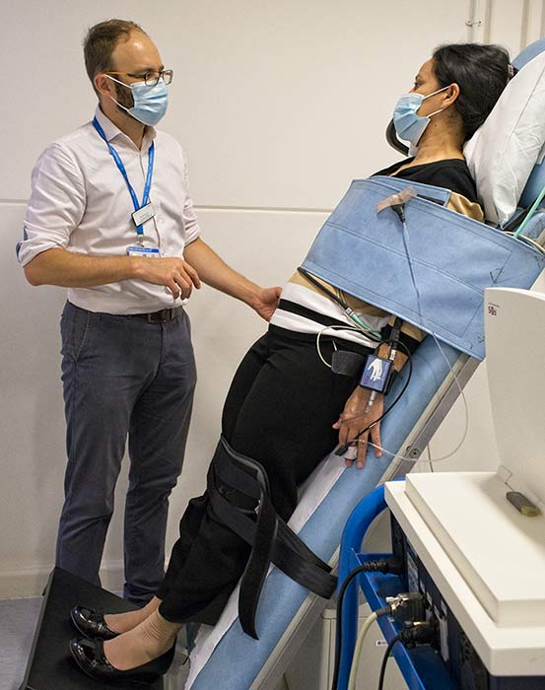
How is it diagnosed?
Review history
Rule out other diagnosis
Active stand test/ tilt test
Consider 24 hr tape and echocardiography
Check vitamin d and iron status

Slide 6
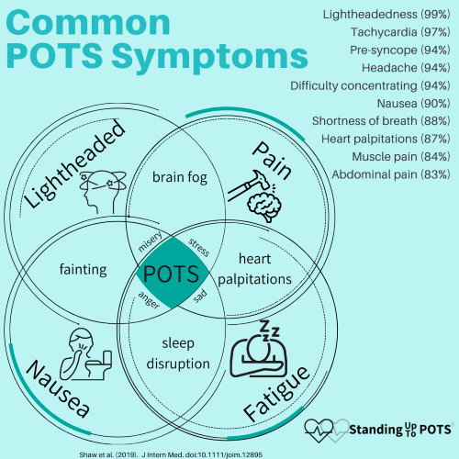
Co existing conditions
May often co exist with
Hyper-mobile joints
Chronic fatigue syndrome
Migraines
Ibs
Depression & sleep disorders
MCAS
May worsen with conditions like
Diabetes, eating disorders, deficiencies

Slide 7

How can this be managed?
Non pharmacological
Increase fluid intake, avoid coffee & alcohol
Increase salt intake
Life style measures- posture change, temperatures, diet
Tight stockings/ compression tights
Elevate head end of bed, ensure good sleep
Reclining exercises, reconditioning physio
Breathing exercises, meditation/ yoga, cbt, support & understanding
Support with education and work

Slide 8

Are medications useful?
Yes if the non pharmacological strategies haven’t helped
In children we use different medications like salt tablets, fludrocortisone, Midodrine, Ivabradine, Bisoprolol, desmopressin etc. these are all unlicensed
Important to be realistic as to what the medications would help achieve

Slide 9
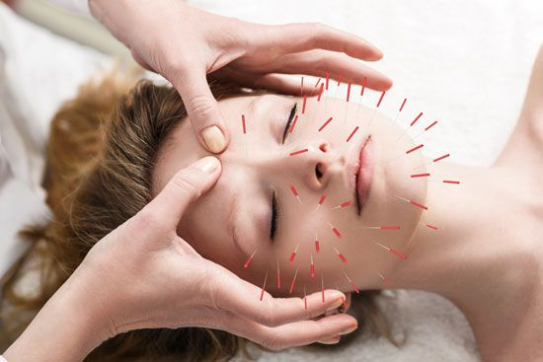
Management of coexisting conditions
Fatigue- pacing, support
Sleep- sleep hygiene and melatonin
Migraines- anti migraine therapy
Pain- acupuncture, hydrotherapy
Breathing difficulties- incentive spirometry
Nausea- frequent small portions, anti emetics, treat constipation
Brain fog- breathing exercise, meditation, Co enz q

Slide 10

Long term outlook
Early diagnosis and management usually prevents longer term sequelae
Usually good for the adolescent type of pots
Can extend to the adult life
Medications not very effective for the deconditioning type
Important to remain optimistic

Slide 11

Questions?

Slide 12

Thank you for listening

