Slide 1
Mast cells, connective tissuE and bladder: connecting the dots
Camila Gonzalez
Advanced Physiotherapy Practitioner - Urology

Slide 2
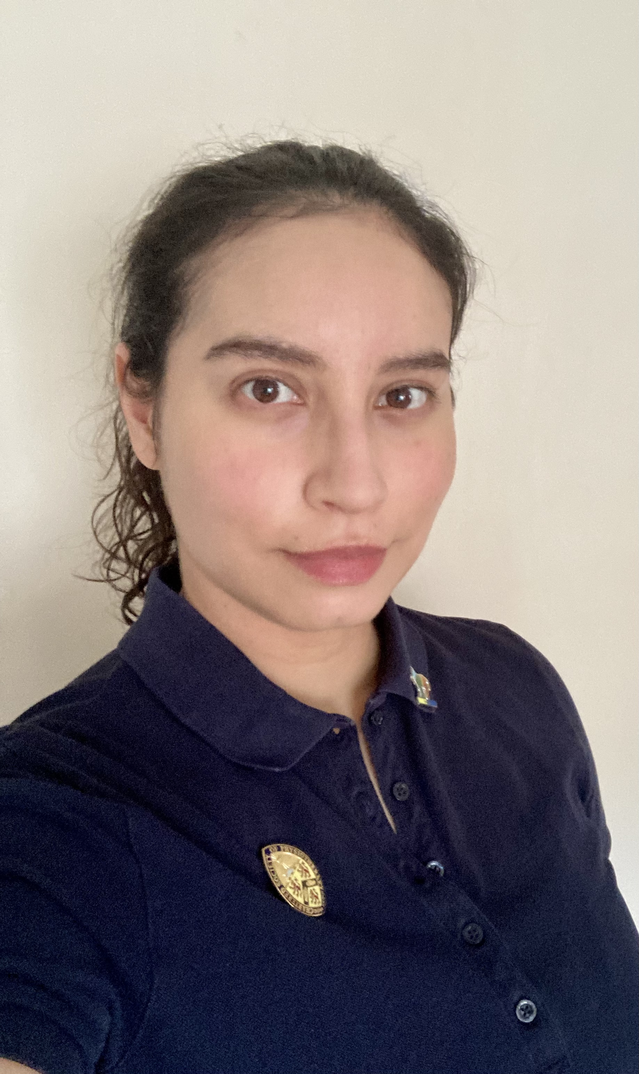
Hello!
Physiotherapy course completed in Chile
Moved to the UK in 2018
Advanced physiotherapy practitioner in Urology in Western General Hospital in Edinburgh
Diagnosed with hEDS/HSD in my childhood
My pronouns are she/they

Slide 3
Trigger warnings
Diagrams (drawings) of pelvic floor muscles, pelvic organs and bladder.
Included diagrams (drawings) of pelvic anatomy of male/assigned male at birth and female/assigned female at birth

Slide 4
Introduction

Slide 5
HSD / hEDS
MCAS
Autonomic dysfunction

Slide 6
Hypermobile EDS + hsd
Ehlers-Danlos Syndromes: Group of connective tissue disorders
13 types
Hypermobile EDS --> meets checklist criteria
Hypermobility spectrum disorder (HSD)
Diagnose given to someone that has generalised joint hypermobility, but does not meet hypermobile EDS checklist criteria
The Ehlers-Danlos Syndromes and Hypermobility Spectrum Disorders The 2017 International Classification

Slide 7
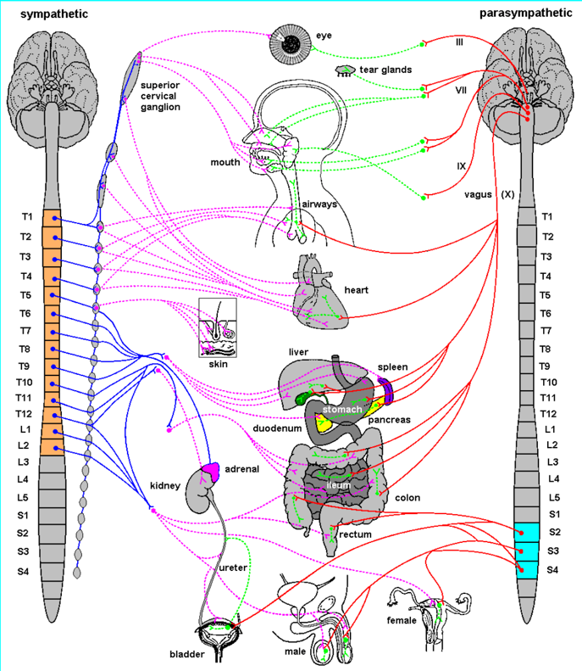
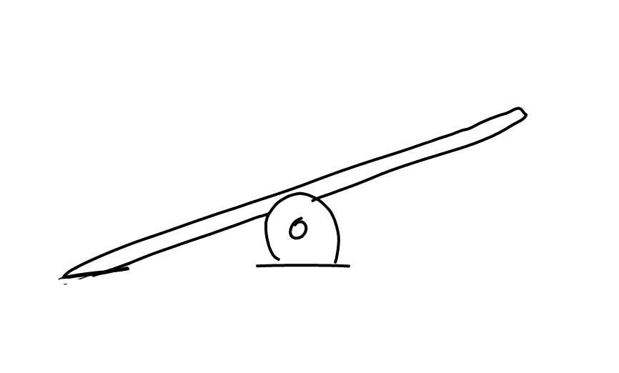
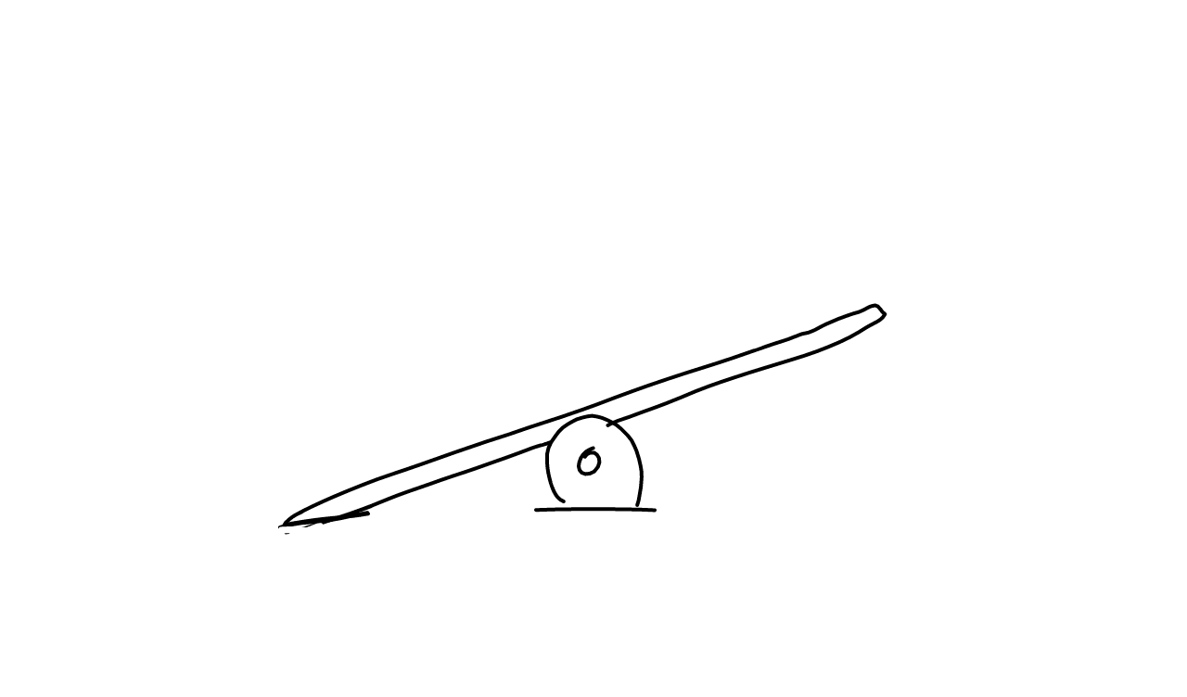
Autonomic dysfunction
Autonomic nervous system dysregulation
One of the best known condition is PoTS (postural tachycardia syndrome)
By Sidca (DeviantArt)
Notes:
Clinical features in autonomic dysfunction:
Cardiovascular: low BP, orthostatic hypotension, postural tachycardia, syncope
Sudomotor: anhidrosis/hyperhidrosis, heat intolerance
Alimentary tract: hypostomia/sialorrhoea, nausea, gastroparesis, constipation
Urinary: frequency, urgency, nocturia, incontinence, retention
Reproductive: erectile and ejaculatory dysfunction
Ocular: miosis/mydriasis/aniscoria

Slide 8
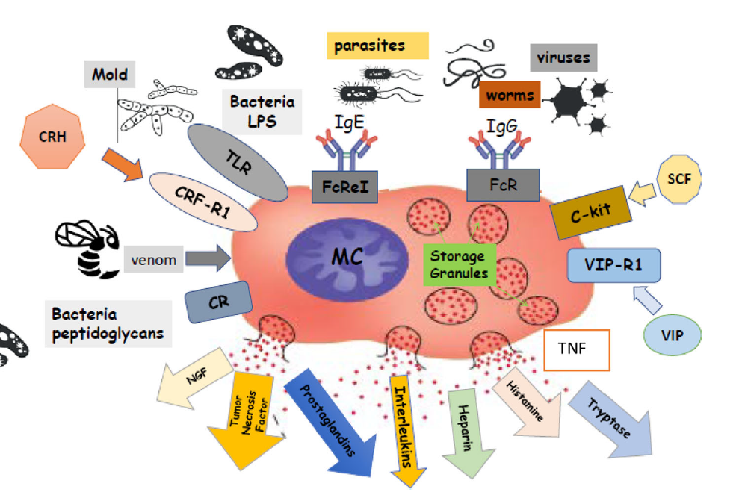
Mast cell activation Syndrome
Mast cells
Homeostasis and coordination of immune responses
Recognise and response to different pathogens and tissue injury
Abundance in connective tissue that borders with the external world
Seneviratne et al (2017)
Seneviratne SL, Maitland A, Afrin L. 2017. Mast cell disorders in Ehlers–Danlos syndrome. Am J Med Genet Part C Semin Med Genet 175C:226–236.
Notes:
Picture: MC activate and release bioactive substances, responding to a variety of mechanical, biological, or chemical stimuli. MCs release preformed mediators in granules (histamine, heparin, serotonin, and enzymes) and newly synthesized (cytokines, growth factors, and lipid metabolites). C-kit, transmembrane tyrosine kinase receptor; CR, complement receptor; CRF-R1, corticotropin releasing factor receptor 1; CRH, corticotropin releasing hormone; FceRI, Fc epsilon receptor I; FcgRI, Fc gamma receptor I; LPS, lipopolysaccharide; MC, mast cell; NGF, nerve growth factor; SCF, stem cell factor; TLR, Toll-like receptor; TNF, tumor necrosis factor-a; VIP, vasoactive intestinal peptide; VIP-R1, vasoactive intestinal peptide receptor 1. Adapted from the following references: [Afrin, 2013; Cardet et al., 2013; Theoharides et al., 2015] and arranged using images from shutterstock.com.

Slide 9
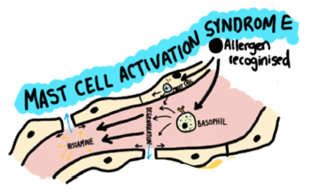
Mast cell activation Syndrome
Mast cell activation syndrome (MCAS)
Increased number of MCs
Increased activity of MCs
Histamine intolerance
Amplified reaction!
Berg and Dockrell (2024)
Seneviratne SL, Maitland A, Afrin L. 2017. Mast cell disorders in Ehlers–Danlos syndrome. Am J Med Genet Part C Semin Med Genet 175C:226–236.
Notes:
Picture: MC activate and release bioactive substances, responding to a variety of mechanical, biological, or chemical stimuli. MCs release preformed mediators in granules (histamine, heparin, serotonin, and enzymes) and newly synthesized (cytokines, growth factors, and lipid metabolites). C-kit, transmembrane tyrosine kinase receptor; CR, complement receptor; CRF-R1, corticotropin releasing factor receptor 1; CRH, corticotropin releasing hormone; FceRI, Fc epsilon receptor I; FcgRI, Fc gamma receptor I; LPS, lipopolysaccharide; MC, mast cell; NGF, nerve growth factor; SCF, stem cell factor; TLR, Toll-like receptor; TNF, tumor necrosis factor-a; VIP, vasoactive intestinal peptide; VIP-R1, vasoactive intestinal peptide receptor 1. Adapted from the following references: [Afrin, 2013; Cardet et al., 2013; Theoharides et al., 2015] and arranged using images from shutterstock.com.

Slide 10
How the water-works work

Slide 11
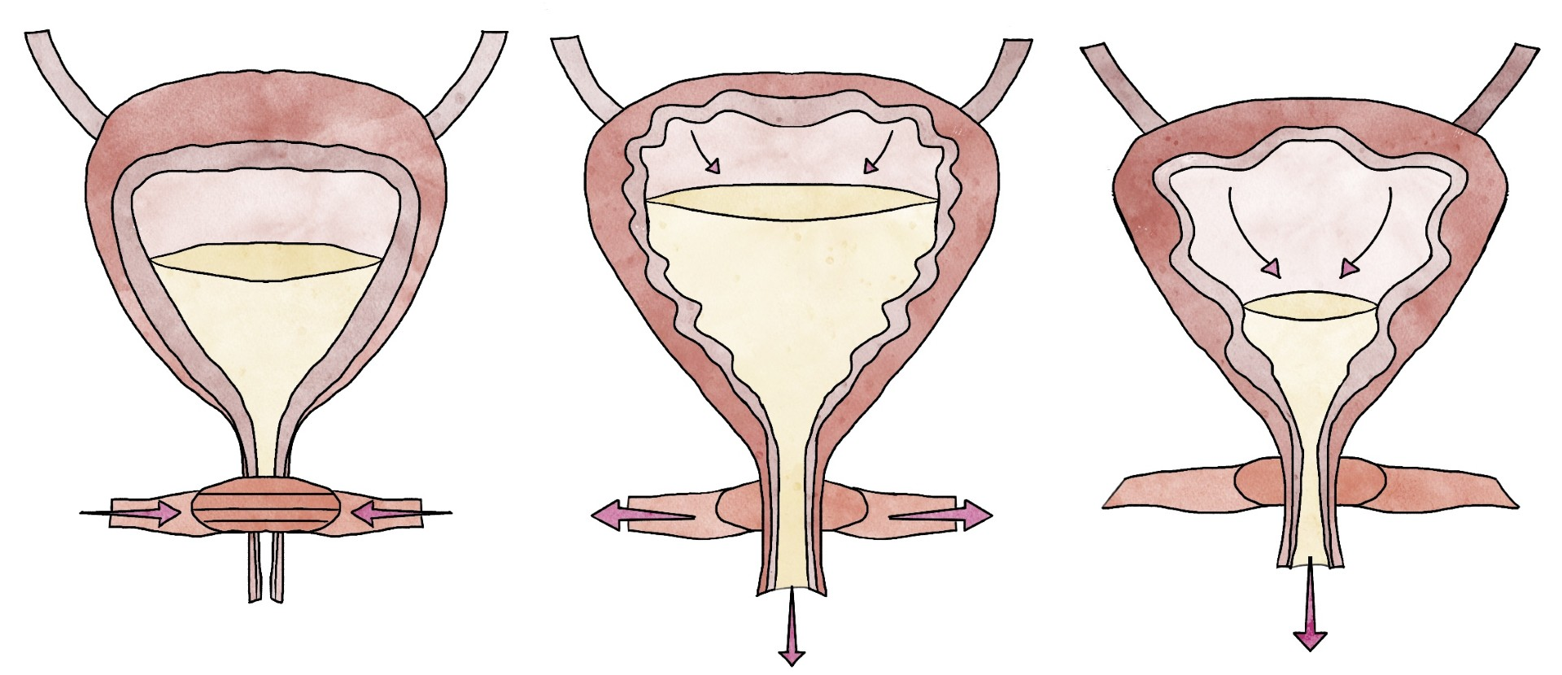
Bladder muscle
Urethral muscle
Pelvic floor muscles
Notes:
Usually, we experience the first sensation to pass urine when the bladder is about halfway full (1/2 pint), and if it is not socially acceptable to go to the toilet, we can ignore it. If we have not been to the toilet, we receive a second sensation when the bladder is 3/4 full, but again is a gentle reminder and we can ignore the bladder if it is still not a good time to go. Then we will feel a third sensation, and this is when most people go to the toilet to pass urine.

Slide 12
Sympathetic Nervous System
“storage”
Parasympathetic Nervous System
“pee”
Storage
Voiding
Sympathetic/
Fight or fly
Parasympathetic/
Rest and digest
Notes:
Usually, we experience the first sensation to pass urine when the bladder is about halfway full (1/2 pint), and if it is not socially acceptable to go to the toilet, we can ignore it. If we have not been to the toilet, we receive a second sensation when the bladder is 3/4 full, but again is a gentle reminder and we can ignore the bladder if it is still not a good time to go. Then we will feel a third sensation, and this is when most people go to the toilet to pass urine.

Slide 13
When the water-works work differently

Slide 14
Bladder muscle
Nerves
Continence cycle
Bladder lining
Patel M & Khullar V. 2021. Urogynaecology and Ehlers–Danlos syndrome. Am J Med Genet Part C Semin Med Genet 187C:579–585.
Notes:
Initial studies have demonstrated a potential relationship between autonomic dysfunction and OAB. Current concepts embrace an integrative hypothesis for urgency and frequency which encloses complex signalling interactions between urothelium (bladder lining), detrusor (bladder muscle), as well as the role of interstitial cells and neural complexes. Perturbations in the regulation of the continence-micturition cycle by the autonomic nervous system may contribute to both sensory and functional detrusor abnormalities.

Slide 15
Symptoms
Storage symptoms
Retention
Recurrent UTI
Urinary incontinence

Slide 16
Storage symptoms
Symptoms that make the storage of urine difficult.
Urgency
Frequency
Nocturia

Slide 17
Urgency
A sudden compelling desire to pass urine that is difficult to delay.
When someone passes urine more than 8 times in a 24-hour period. The average is between 4-7 times and/or every 2-4 hours during waking hours.
When someone passes urine more than once per night.
Frequency
Nocturia

Slide 18
Urinary incontinence
Urinary incontinence (UI) is the involuntary loss of urine.
Stress urinary incontinence
Urge urinary incontinence
Overflow incontinence
Mixed urinary incontinence

Slide 19
Voiding dysfunction or retention
Difficulties and/or inability to voluntary urinate.
Connective tissue
Bladder muscles
Functional
Patel M & Khullar V. 2021. Urogynaecology and Ehlers–Danlos syndrome. Am J Med Genet Part C Semin Med Genet 187C:579–585.
Notes:
Problems of connective tissue in the pelvic floor, resulting in pelvic organ prolapse, which obstruct bladder emptying.
Defect in the connective tissue in the bladder wall affecting bladder muscle function.
Functional: in absent of obstructive or bladder muscle problems.

Slide 20
Recurrent urinary tract infections
Infection
Mild/Mod response
Infection cleared
> response
Ability to invade bladder wall
Damage lining wall
RUTIs
Prof V Khullar

Slide 21
Pelvic floor muscles

Slide 22
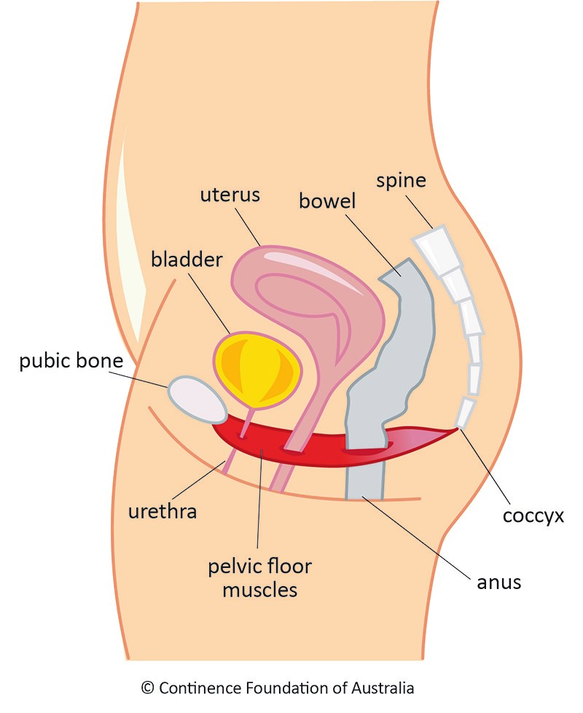
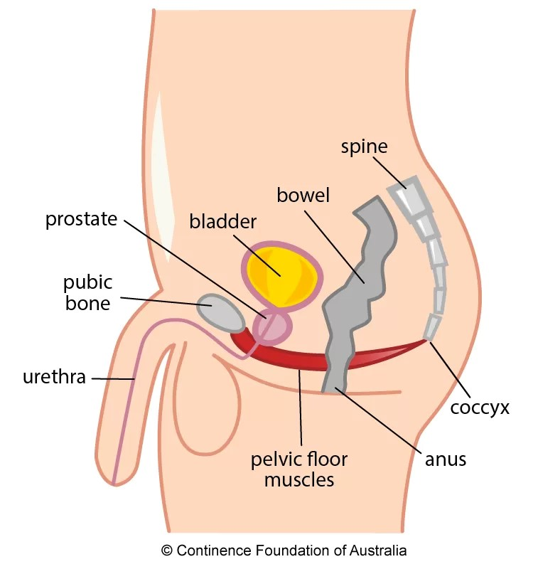
Warning:
Drawing of pelvic anatomy and muscles for both assigned female at birth and assigned male at birth

Slide 23
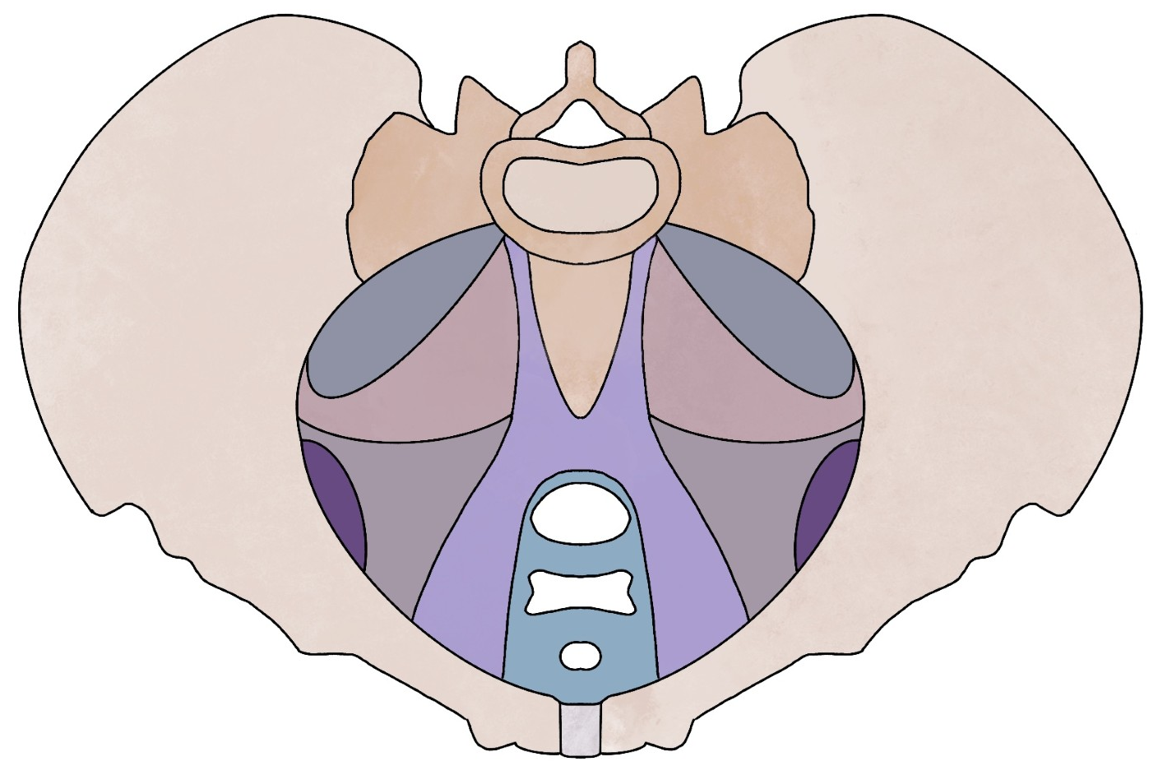
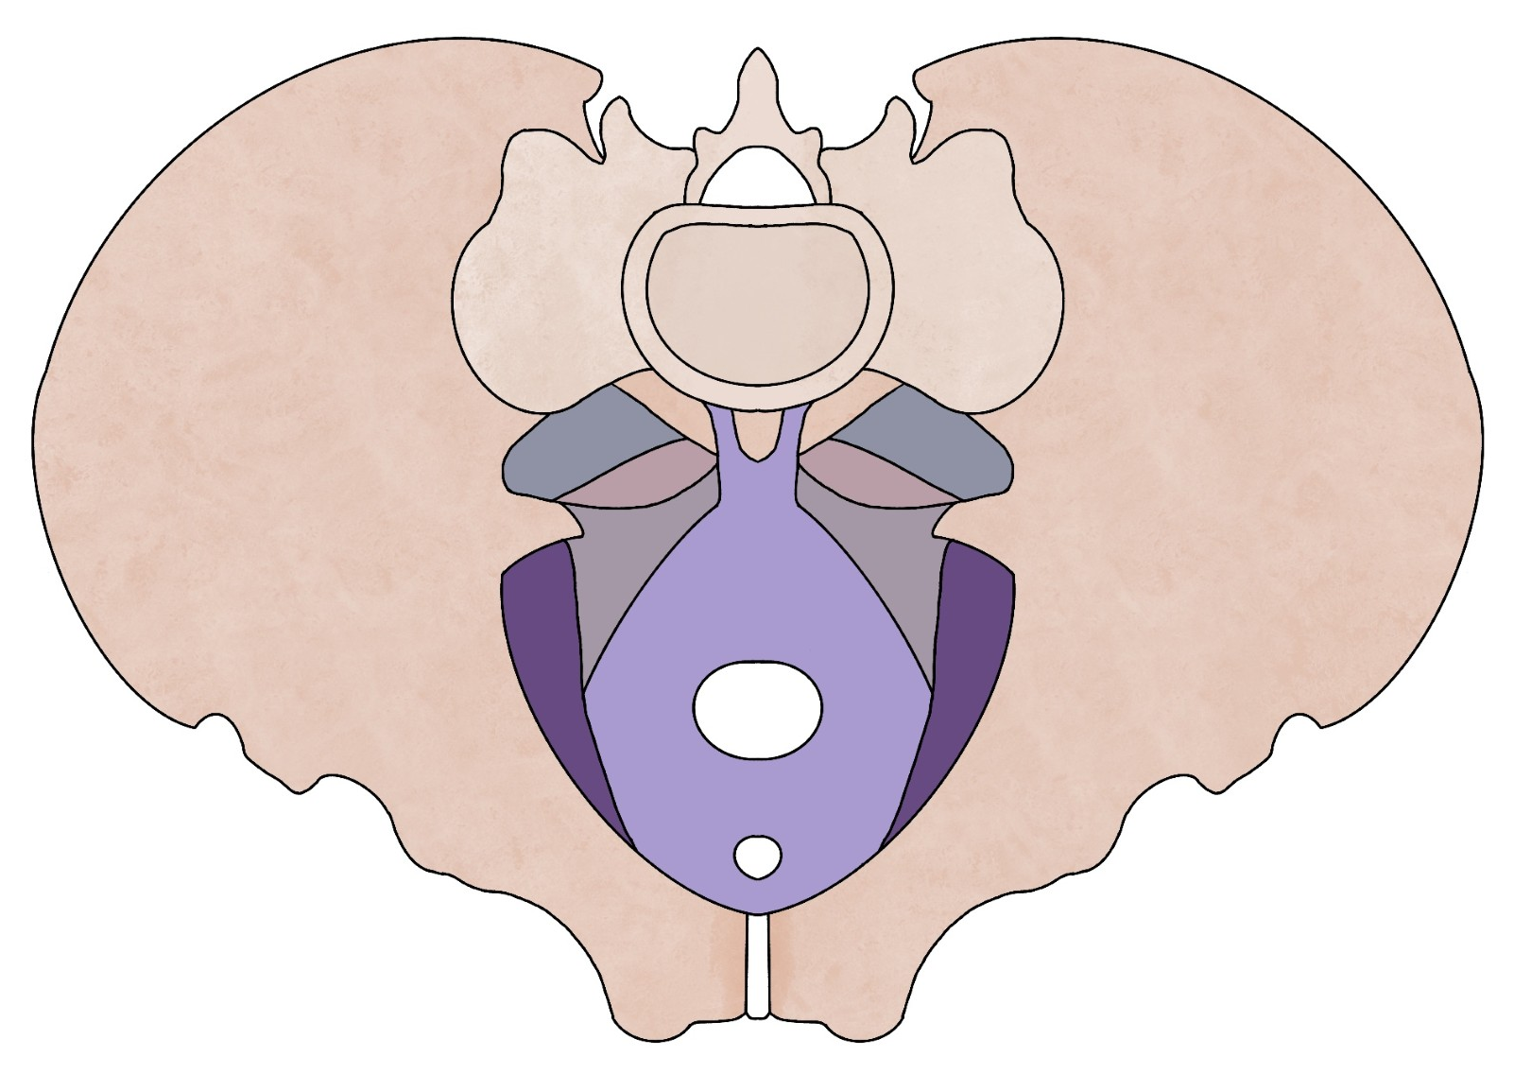
Assigned male at birth
Assigned female at birth

Slide 24
Over-active ”tense” muscles
Under-active ”weak” muscles

Slide 25
HSD / hEDS
MCAS
Autonomic dysfunction

Slide 26
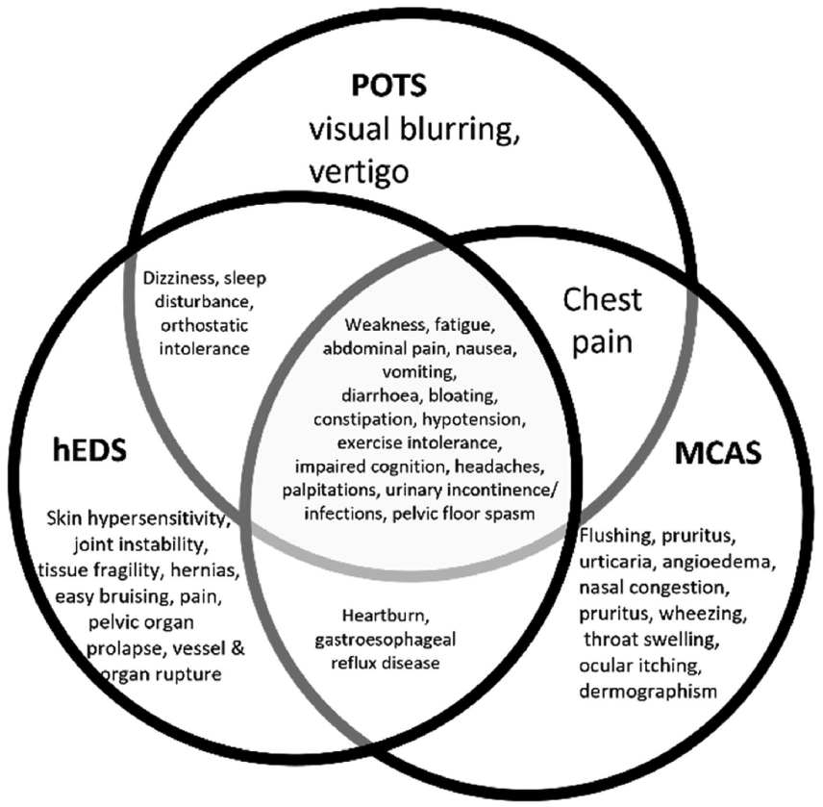
HSD / hEDS
MCAS
Autonomic dysfunction
Patel M & Khullar V. 2021. Urogynaecology and Ehlers-Danlos syndrome. American Journal of Medical Genetics;187C:579–585..

Slide 27
Self management

Slide 28
Disclaimer
This is not medical advice
If you have questions about your own symptoms, please speak to your GP

Slide 29

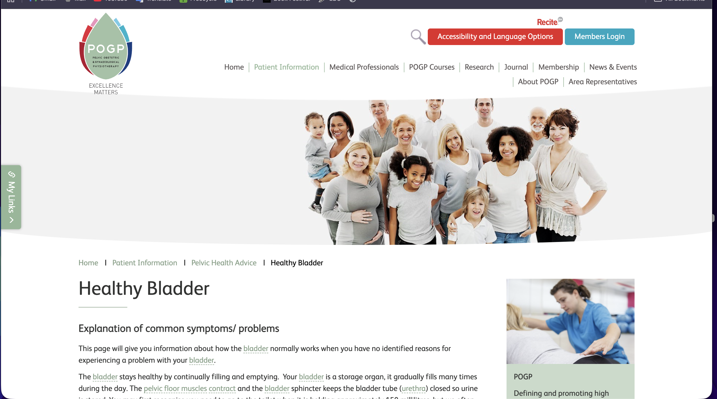

Slide 30
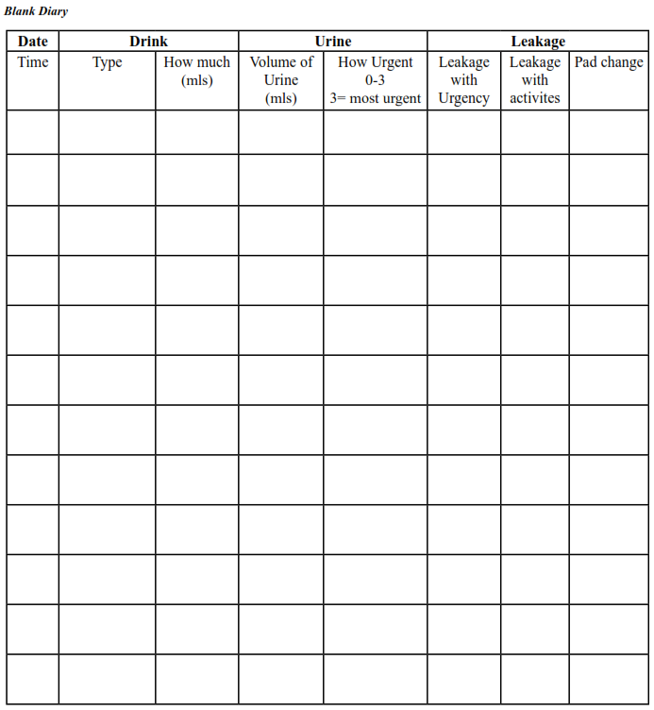
Bladder diary

Slide 31
Fluid advice
Total daily fluid intake 1 ½ to 2 litres.
Keep hydrated. Dehydration causes concentrated urine and constipation which can irritate the bladder further.
Make sure you are drinking regularly during the day.
Avoid having too many drinks that can irritate your bladder.

Slide 32
Bladder training
Aims to train your bladder to be able to hold more urine comfortably
When you feel the urge, avoid rushing to the toilet
Suppression techniques
Beginning with delaying going to the toilet for a few minutes, and slowly increase time between voids, until you pass urine every 2-4 hours
Bladder Retraining on Vimeo

Slide 33
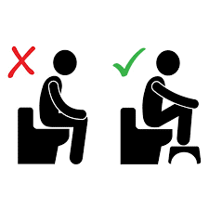
Positioning
Do not rush when emptying your bladder
Sit on the toilet take some deep breaths and relax.
Empty your bladder regularly, every 3 – 4 hours on average.
Double voiding.
Healthy Bladder | POGP (thepogp.co.uk)

Slide 34
Pelvic floor exercises
Strengthening, also known as ”kegel” exercises
Down training → relaxing pelvic floor muscles

Slide 35
Pelvic floor exercise training
Internal lift
Back to front
Long holds: up to 10 seconds hold, up to 10 times in 1 set.
Short holds: less 1 second before letting go, up to 10 repetitions in 1 set.
Pelvic Floor Strengthening Exercises in Women on Vimeo

Slide 36
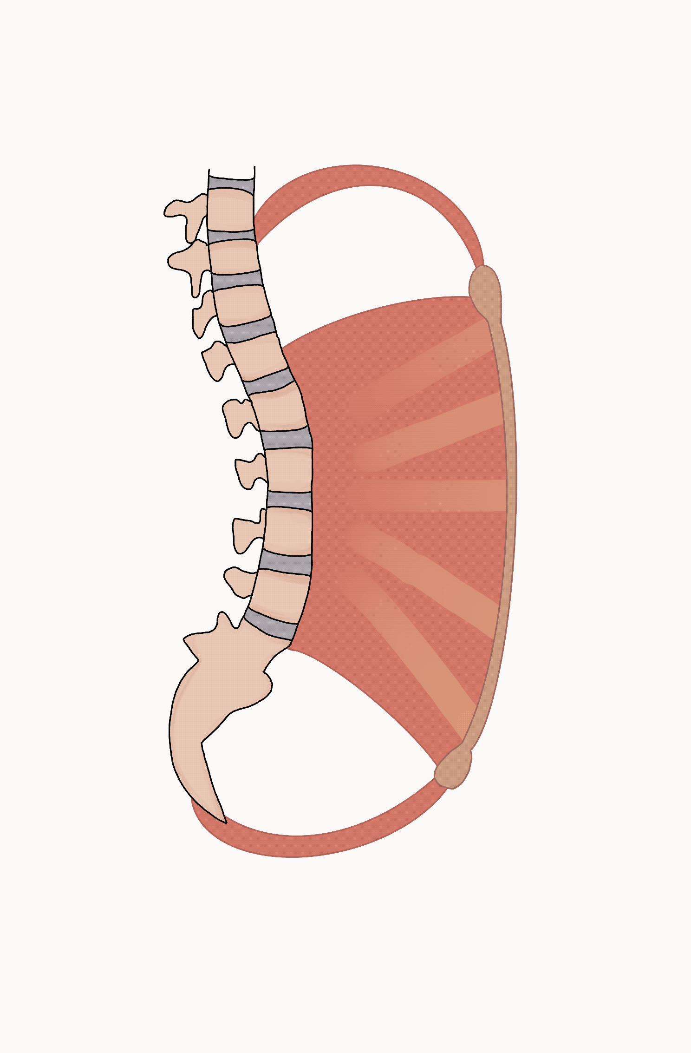
Breathing exercise
Breathe in gently in through your nose directing air to the bottom of your lungs.
Breathe out lightly through your nose if possible without pushing and with your abdominals (tummy) relaxed.
Make sure you relax and pause at the end of each breath.
When you breathe in, your upper chest should be relaxed and not moving.

Slide 37
General exercise
Pilates
Yoga
Walking

Slide 38
Final thoughts
HSD / hEDS
MCAS
Autonomic dysfunction
Changes in bladder lining, muscles and or support can lead to bladder symptoms
Different resources available to self-manage these symptoms
Approach your GP

Slide 39
Resources
Urology physiotherapy NHS Lothian: Urology Physiotherapy – NHS Lothian | Our Services
Happy bladder POGP: Healthy Bladder | POGP (thepogp.co.uk)
Bladder retraining video: https://vimeo.com/593194051/3922d527e5
Pelvic floor exercises video: https://vimeo.com/593193863/674bdd1458

Slide 40
THANK YOU
Camila Gonzalez
Advanced Physiotherapy Practitioner - Urology

