Slide 1


Food Fear In MCAS
Understanding it, preventing it, and finding your way back to food
Alison Holloway - The Unexpected Dietitian and Nishti Udeh - Nishti’s Choice
28 September · For those living with MCAS, and for parents supporting a child with MCAS
Notes:
Welcome everyone. Name at the start that this session speaks to two audiences in the same room: adults living with MCAS themselves, and parents supporting a child with MCAS. Almost everything covered applies to both. A few sections, flagged as we go, speak directly to parents.

Slide 2
What is food fear?
Food fear is more than simply disliking a food or wondering whether it might agree with you. It is when eating a particular food, or trying something unfamiliar, starts to feel genuinely unsafe or threatening.
The body’s threat response can become activated
The fight-or-flight response kicks in, which can cause nausea, shaking, dizziness or palpitations.
For those of you dealing with MCAS alongside PoTS or dysautonomia: the symptoms of the fear and the symptoms of the illness already overlap, which makes this harder to untangle.
Notes:
Food fear is much more than not liking a food, or normal worry about whether a food won’t agree with you. It is when eating particular foods, or trying something unfamiliar, begins to feel threatening or unsafe. Because food feels unsafe the body reacts as if under threat – your flight or fight system responds causing physical symptoms such as nausea, shaking, dizziness and palpitations. For those of you dealing with MCAS alongside conditions like PoTS/dysautonomia you can see how this is tricky as the symptoms overlap.

Slide 3



This fear is rational
When you have a chronic illness like MCAS, where food can genuinely cause symptoms, this fear is rational and normal. It can involve fear of:
Retrying foods
previously eliminated
Having another reaction
that triggers a flare
Anaphylaxis
and hospitalisation
Notes:
When you have a chronic illness like MCAS where food can cause symptoms, this fear is perfectly rational and normal and can involve fear of: retrying foods previously eliminated; having another reaction that triggers a flare; anaphylaxis and hospitalisation.

Slide 4
Protection can become a problem
The protective response starts applying to whole groups of food
That leads to increasing restriction, distress, and reduced quality of life
Eating becomes connected to pain and distress, rather than nourishment, joy, and social connection
The body and mind remember this
Notes:
The difficulty comes when that protective response begins to apply to big groups of foods, leading to increasing restriction, distress and reduced quality of life. Eating becomes connected to pain and distress rather than nourishment, joy and social connection, and the body and mind remember this.

Slide 5
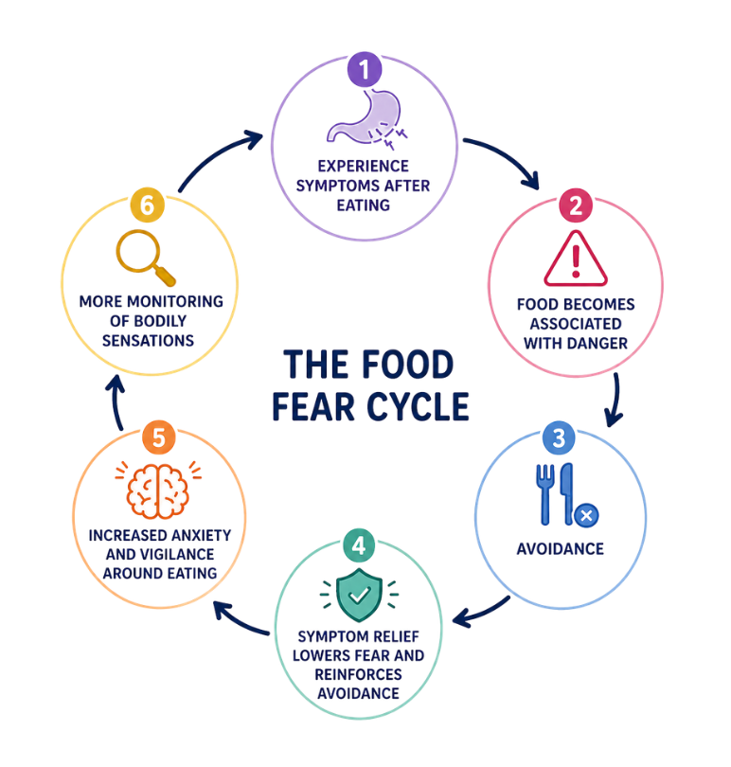
The food fear cycle
The aim is to interrupt the cycle at any point.
Small changes that;
increase safety
maintain nutrition
reduce restriction
Can help prevent it becoming established.

Slide 6

Why does food fear develop in MCAS?
Notes:
Transition into the four reasons food fear develops specifically in MCAS: unpredictability, symptom overlap, lack of support, and information overload.

Slide 7

Unpredictability
MCAS symptoms can be unpredictable. A person may:
Tolerate a food one day
Experience symptoms after it another day
Tolerate a small amount but not a larger amount
React only when several other triggers are present
That makes it extremely difficult to establish simple rules about what is and isn’t safe.
Notes:
Unpredictability - MCAS symptoms can be unpredictable. A person may: tolerate a food one day; experience symptoms after it another day; tolerate a small amount but not a larger amount; react when several other triggers are present. That makes it extremely difficult to establish simple rules about what is and isn’t safe.

Slide 8

Symptoms overlap
Some symptoms associated with MCAS and connected conditions like PoTS/dysautonomia overlap with symptoms associated with the body’s own stress response.
Sweating · Palpitations · Dizziness · Altered breathing · Nausea · Gut symptoms
Which is which, in the moment, is really hard to tell apart.
Notes:
Some symptoms associated with MCAS and connected conditions like PoTS/dysautonomia can overlap with symptoms associated with the body’s stress response. For example, sweating, palpitations, dizziness, altered breathing, nausea and other gut symptoms.

Slide 9

Lack of support
Unclear diagnosis and a lack of professional support and responsiveness can leave you worried, and having to try and manage things alone.
Notes:
Unclear diagnosis and lack of professional support and responsiveness can leave you worried and having to try and manage things alone.

Slide 10
Information overload
People with MCAS are exposed to huge amounts of diet and symptom information
Strong messages about avoiding foods, and suggestions that certain foods are unsafe
“Perhaps I should stop eating this too, just to be safe.”
If you are struggling and unsupported, that thought is understandable.
Notes:
People with MCAS are exposed to huge amounts of diet and symptom information. There are strong messages about avoiding foods and suggestions that certain foods are unsafe if you have MCAS. If you are struggling and unsupported it is understandable to think: “Perhaps I should stop eating this too, just to be safe.”

Slide 11
Preventing food fear in MCAS
Prevention starts with not restricting more than is genuinely necessary: avoid avoiding
Avoid restricting based on what you might react to, or what others react to
Every elimination diet has a reintroduction phase, and it is essential, not optional
This is hard in reality, and many of you here will already be dealing with food fear.
Notes:
Prevention starts with not restricting more than is genuinely necessary – avoiding avoiding! Avoid restricting based on what you might react to or what others react to. All elimination diets have a reintroduction phase and that should be seen as essential not optional. I know in reality this is hard and that many of you here will already be dealing with food fear.

Slide 12

Managing food fear
Three common mistakes, and what to do instead
Notes:
Leads into management. Three common mistakes: working it out alone, letting the present hijack the future, and, for parents, projecting fear onto a child.

Slide 13

One: trying to work it out alone
There’s more diet and symptom information available now than ever before, most of it generic, none of it built for your body or your child’s specifically. Following it without guidance is how one elimination turns into a downward spiral: cut a food, still react, cut another, then another, until what’s left on the list is smaller than what’s gone.
Food is a specialised area. Somehow, nowadays, everyone seems like an expert in it. Be very critical about who you take advice from, and who you entrust with your body.
Notes:
There’s more diet and symptom information available now than ever before, most of it generic, none of it built for your body or your child’s specifically. Following it without guidance is how one elimination turns into a downward spiral: cut a food, still react, cut another, then another, until what’s left on the list is smaller than what’s gone. Food is a specialized area. Somehow, nowadays, everyone seems like an expert in it. Be very critical about who you take advice from, and who you entrust with your body.

Slide 14

Two: letting the present moment hijack the future
One flare, one frightening reaction, and the mind writes the ending. This is my life now. It will only get worse from here. I will never eat safely again. A single moment, still unfolding, gets treated as proof of how every future moment will go.
The present moment hijacks the future.
This is exactly where mindfulness fits: not a wellness add on, but a direct answer to this pattern. Staying with what is happening now, a stomach that hurts today, without signing your name to a story about every day after it.
Notes:
One flare, one frightening reaction, and the mind writes the ending. This is my life now. It will only get worse from here. I will never eat safely again. A single moment, still unfolding, gets treated as proof of how every future moment will go. This is exactly where mindfulness fits, not as a wellness add-on, but as a direct answer to this pattern. It is the practice of staying with what is happening now, a stomach that hurts today, without signing your name to a story about every day after it.

Slide 15

Three: projecting your fear onto your child
FOR PARENTS
A parent’s relationship with food may show up in their parenting
A child’s body and a parent’s fear can start to feel like the same thing, especially after a frightening reaction
A child’s relationship with food can be a major trigger in a parent
A child can absorb a parent’s hypervigilance around food long before they understand why it is there
The solution: presence. Noticing whether a reaction, in this moment, is coming from what your child’s body is telling you, or from what happened last time.
Notes:
This one applies specifically to those of you here as parents. A child’s body and a parent’s fear can start to feel like the same thing, especially after a frightening reaction. They are not the same thing, and a child can absorb a parent’s hypervigilance around food long before they understand why it is there. We will come back to this properly when we get to the two arrows, because parents carry a second arrow of their own. The solution is the same one: presence. Noticing whether a reaction, in this moment, is coming from what your child’s body is telling you, or from what happened the last time.

Slide 16

Fear, lack, and abundance
A decision from fear (scarcity)
A decision from abundance (love)
A food confirmed to cause anaphylaxis stays off the table for now. Everything else needs a clinical rationale before elimination.
Flare ups does not mean my child’s future is doomed.
Everyday is a new day, I will approach is as best as I can and not from my fearful mind.
Mentality rooted in trust, courage and self worth.
I need to eliminate all these foods as I read it online
Treating one flare as the whole future
“My child will never get better”
Mentality rooted in past conditioning, unworthiness, anxiety.
Notes:
Look at what the three mistakes above have in common. Outsourcing judgment to strangers online, treating one flare as the whole future, treating a child’s body as a mirror for a parent’s fear: every one of these is a decision made from fear rather than from what’s actually true in front of you. Fear, when it’s driving, is always operating from a sense of lack: not enough safety, not enough certainty, not enough control. Decisions made from lack tend to produce more lack. Cut a food out of fear rather than evidence, and the list of safe foods gets smaller, not the fear. Restrict a child’s world to protect them from an imagined worst case, and the world left for them to grow up in gets smaller too, not safer. The outcome mirrors the starting point. A decision rooted in scarcity produces a scarcer life, even when the intention behind it was protective. None of this argues for recklessness. A food confirmed to cause anaphylaxis stays off the table. That’s evidence, not fear. The distinction is which one is actually steering: what you know, or what you’re afraid of. That’s the bridge into mindfulness. Presence is what lets you tell the two apart, in the moment, before the decision gets made.

Slide 17

Mindfulness and mindful eating
Notes:
Prevention only goes so far once you’re already inside the cycle. This is where mindfulness comes in.

Slide 18
What is mindfulness?
It doesn’t replace medical care. It gives you a way to meet the fight-or-flight response you just saw or felt, instead of being run by it.
Noticing what’s happening in your body and mind, right now, without immediately reacting to it or judging it.
For food fear specifically: noticing the alarm bells, the racing heart, the tight stomach, the urge to say no before you’ve even looked at the plate, as information rather than as a command.
Notes:
Prevention only goes so far once you’re already inside the cycle. This is where mindfulness comes in. It doesn’t replace medical care. It gives you a way to meet the fight or flight response you just read about, instead of being run by it. Mindfulness is the practice of noticing what’s happening in your body and mind, right now, without immediately reacting to it or judging it. For food fear specifically, that means noticing the alarm bells, the racing heart, the tight stomach, the urge to say no before you’ve even looked at the plate, as information rather than as a command.

Slide 19

What is mindful eating?
That same noticing, applied to food: hunger, fullness, taste, how your body responds, without the running commentary of good food or bad food and societal food rules. Mindful eating is an opportunity to practice mindfulness!
The BASICS of Mindful Eating (Breathe, Assess, Slow, Investigate, Chew, Savor)
Nobody in this room needs to eat through a reaction to prove they’ve healed their relationship with food. It means getting quiet enough to notice which signal you’re dealing with, then pairing that with the tools already covered: reintroduction, the symptom diary, your team.
Notes:
Mindful eating takes that same noticing and applies it to food specifically. It means paying attention to hunger, fullness, taste, and how your body responds, without the running commentary of good food or bad food. For most people, mindful eating rests on one assumption: that the body’s signals can be trusted once old habits and diet rules stop getting in the way. With MCAS, that assumption needs an asterisk. Some of what your body tells you during or after a meal is completely trustworthy. Some of it might be a genuine reaction. In the moment, the two can feel identical. Nobody in this room needs to eat through a reaction to prove they’ve healed their relationship with food. Mindful eating here means getting quiet enough to notice which signal you’re dealing with, then pairing that noticing with the tools already covered: the
(Mindful eating is not another diet, a weight loss strategy, not about food but our relationship with it). reintroduction process, the symptom diary, working with your team.

Slide 20

The two arrows
A Buddhist teaching
Notes:
There’s a Buddhist teaching that fits well here.

Slide 21

The two arrows
First arrow
Second arrow
The pain/reaction itself
The physical reaction: stomach pain, hives, the fatigue that follows a flare
Outside our control
Having a diagnosis like MCAS
The stories we add on top
The guilt, the catastrophising, the story that starts the moment the first arrow hits
“The foods I have to give up now.” “The trip I’ll never take.”
In our control (monkey mind)
Struggling with acceptance
Notes:
There’s a Buddhist teaching that fits well here. The first arrow is the pain itself. For you, that might be the physical reaction, the stomach pain, the hives, the fatigue that follows a flare. That arrow sits mostly outside your control. It happens, and no amount of mindfulness prevents a genuine mast cell reaction. The second arrow is what gets added on top: the guilt, the catastrophising, the story that starts the moment the first arrow hits, the foods I have to give up now, the trip I’ll never take, the meals I’ll never enjoy again. That second arrow is optional. Not easy to put down, but optional. It’s the one this section is really about.

Slide 22
If you’re here as a parent
First arrow
Second arrow, now yours
Still your child’s reaction/diagnosis
The guilt you carry
The hypervigilance that creeps into every future meal
The catastrophising about a future you haven’t reached yet
The second arrow = mental proliferation.
A parent’s second arrow can leave as much of a mark on a child’s relationship with food as the first arrow did.
Notes:
If you’re here as a parent rather than as the person with MCAS, your two arrows look slightly different. The first arrow is still your child’s reaction, still outside your control. The second arrow becomes yours: the guilt over what you fed them, the hypervigilance that creeps into every future meal, the catastrophising about a future you haven’t reached yet. Naming that difference is worth doing, because a parent’s second arrow can leave as much of a mark on a child’s relationship with food as the first arrow did.

Slide 23
The first arrow isn’t ours to control. The second one is.

Slide 24
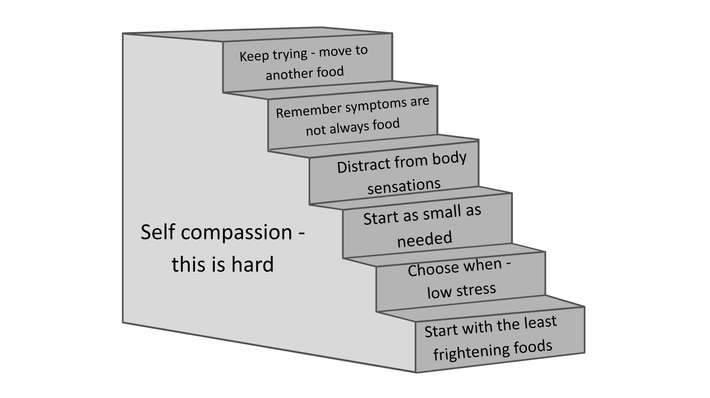
Practical steps for reintroducing foods

Slide 25

Thank you
Questions & discussion
Notes:
Thank you. Open up for questions and discussion.

Slide 26
